Slide 1
Growth of world population and prediction
Presented By:
Happiness Ndubisi 041075639
Palak Rohela 041089784
Karandeep Singh 041042181
Anurag Singh 041056392

Slide 2
Data Dictionary
Data Dictionary
Mortality: Rate at which people die represented in numerical value
Fertility rate: The rate at which people put to birth represented in numerical values.
Natural changes: Birth minus Death represented in numerical values.
Year: year the data was gotten, year of projection which is from 1950 to 2100
Region: Region in the world, and the data set has 6, Africa, North America, Asian, Europe, Oceania and the South America
SDG Regions(Sustainable Devleopment Goals): Sub-Saharan Africa, Northern Africa and Western Asia, Central and Southern Asia, Eastern and South Eastern Asia, Latin America and Caribbean, Oceania, Australia/New Zealand, Europe and Northern America.

Slide 3
Data Dictionary
More Developed Regions: This includes some of the nations like
Less Developed Regions: Ethiopia, Tanzania, and Yemen,
Least Developed Regions: Afghanistan, Bangladesh, Haiti, and Malawi

Slide 4
Project Abstract
In this project, we took into consideration multiple factors that influences population growth either positively or negative, factors such as mortality rates, fertility rates, migration patterns, natural chances and GDP.
These factors were carefully analyzed and virtualized to have a clear view on the level positive or negative impact they have on population dynamic and projections to provide a holistic understanding of global population trends.

Slide 5
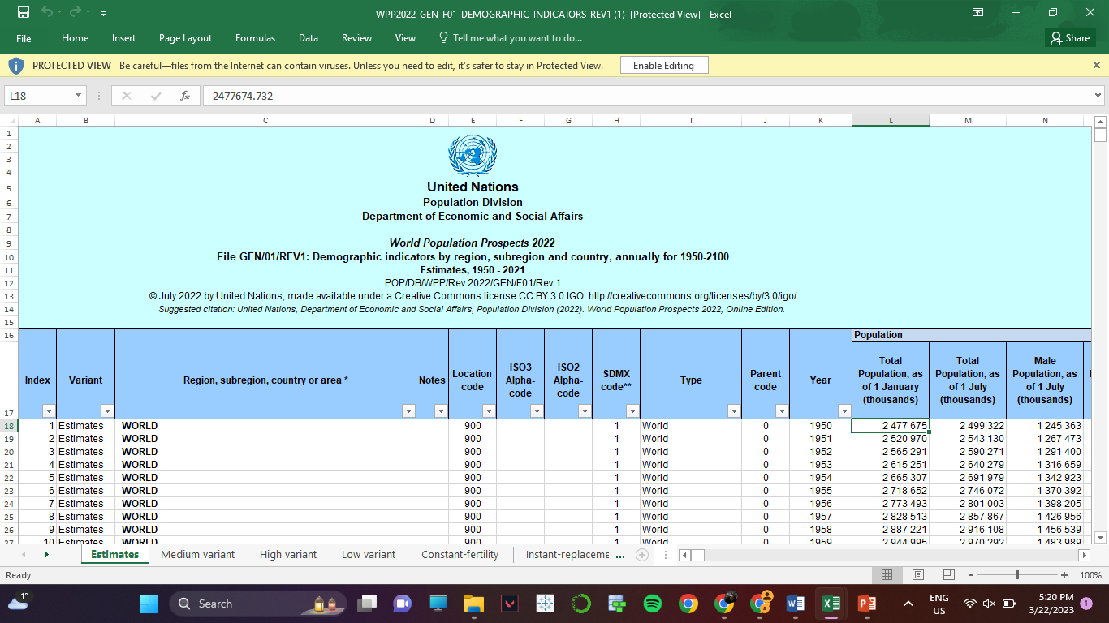
Original Dataset

Slide 6


Problem Statements
How will the global demographics change in the next decades?
What is the influence of Migration on Population?
What is the mortality rates of the population?
What are the veers of Death rates of males and females around the globe?
How does fertility rate is affected?
What is the effect of Natural changes on the population?

Slide 7
Population analysis based on World

Slide 8
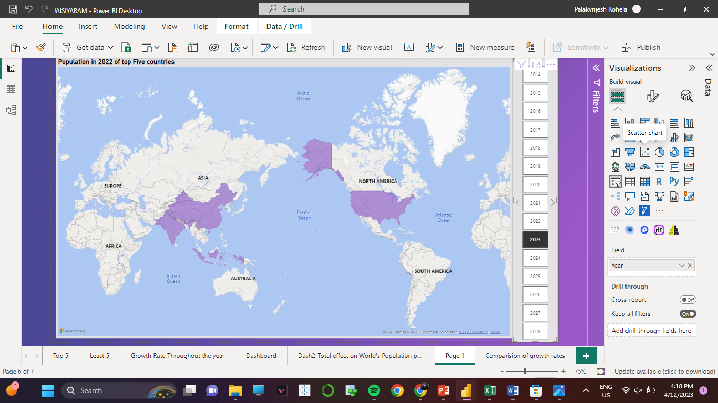
Map showing Population density in top 5 countries around the world year wise

Slide 9

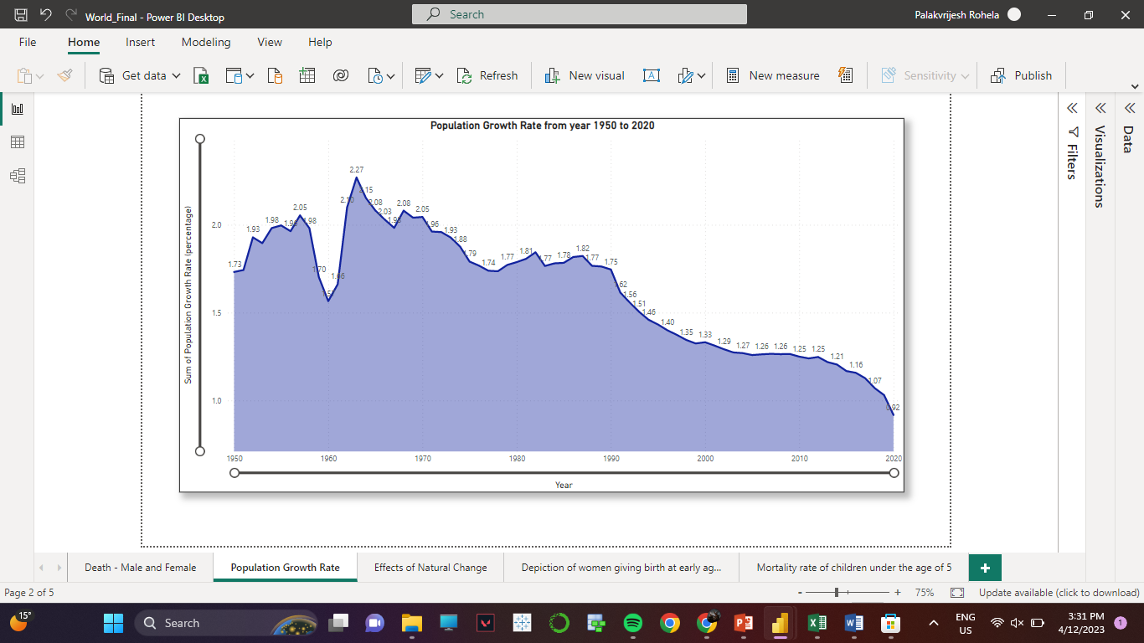

Slide 10
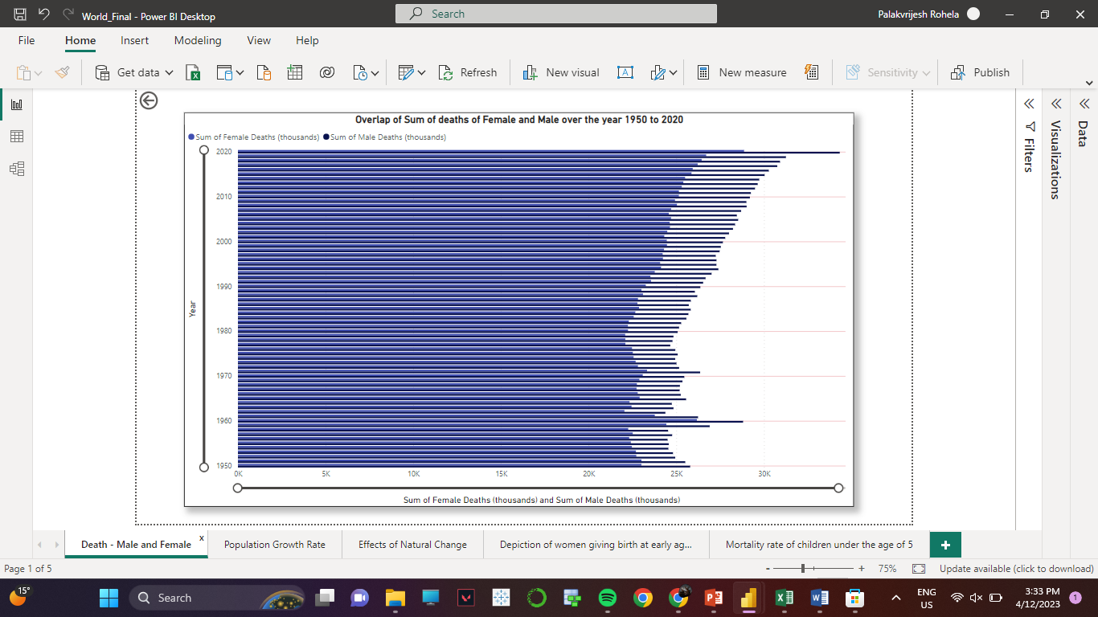


Slide 11
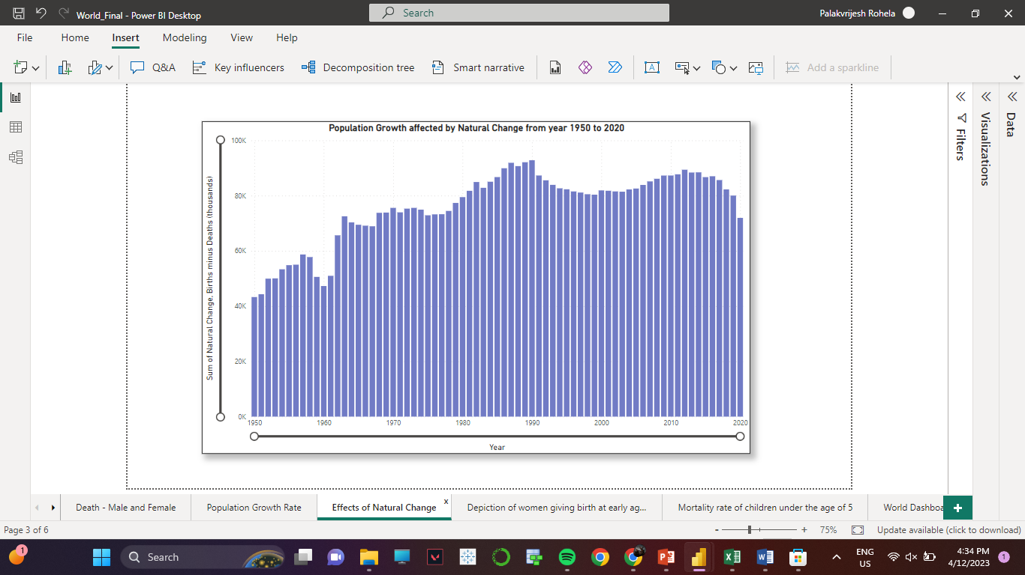

Slide 12
Population analysis based on Regions

Slide 13
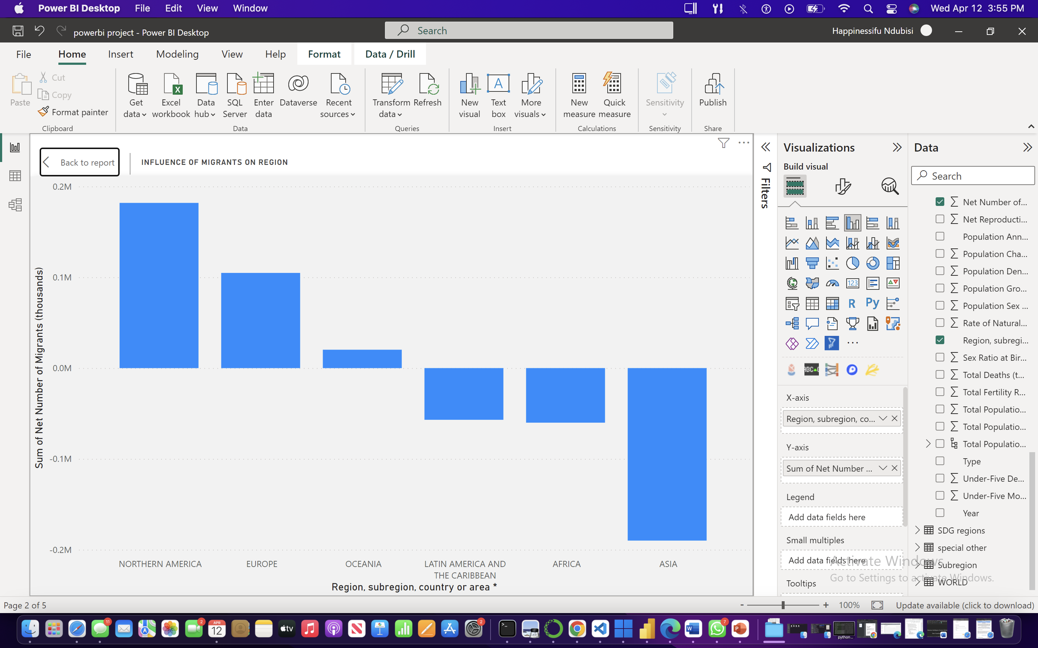
It was seen that immigration is one of the factors that influences population growth of North America. Around one in five (58.71 million) of the 281 million world migrants lived in Northern America in 2020 [5] According to research about 4million people are migrating to the north America, apart from the developed countries in North America and people migrating there for better opportunities countries like the United State, Canada host a large number of refugees and asylum seekers , in 2020 and the United State host about 1.27 asylum seekers and refuges while Canada about 205,00
From the visual analysis it was seen that in terms of Migration, Asian’s population is decreasing follow by Africa and this is the trend is projected to continue until 2100 this could due to factors like decline in economic and employment opportunities due to high population in Asian countries hence an increase in migration for people to search for better opportunities

Slide 14
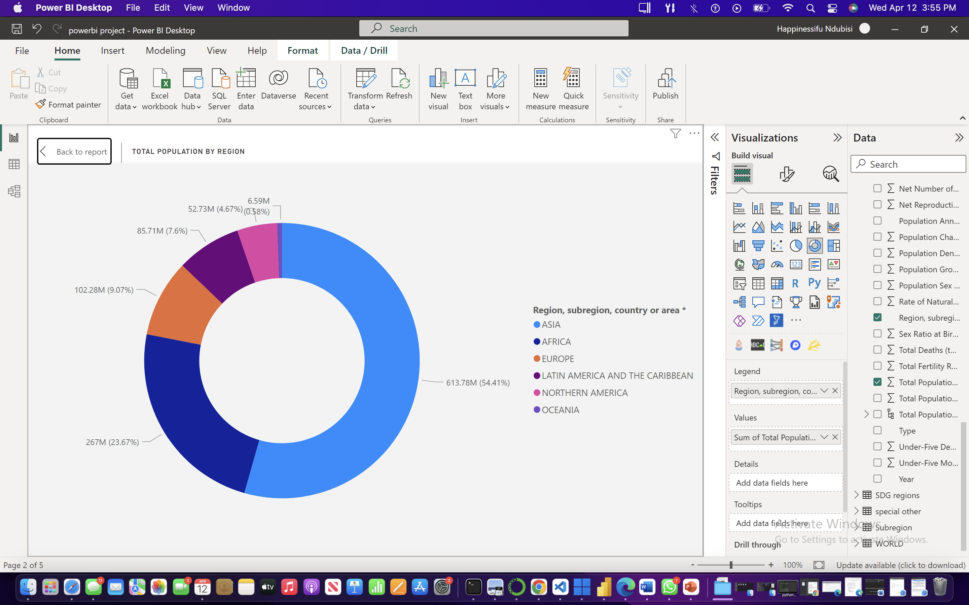
From the visualization it was seen that Asian occupy more than 50% person of the world’s population, about 54.41% which is round 613.78 million people precisely and Africa which is the next populated region has about 23.67% that is 267million people, the least Populate region is Northern America despite having high rate of immigrant

Slide 15
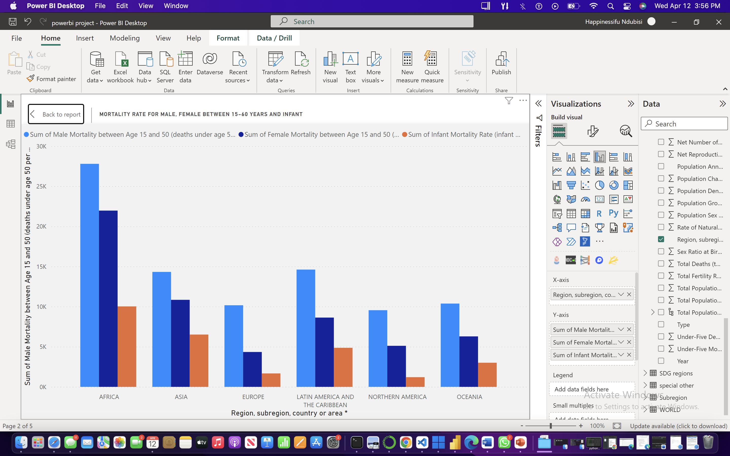
From the chart African has the highest mortality rate for male, female, and infant next to Asia the region with the less among all regions is Oceania next to North America, from previous chat we understood that Asian and Africa are the most populated and that could be a factor for the high mortality rate in the region.

Slide 16
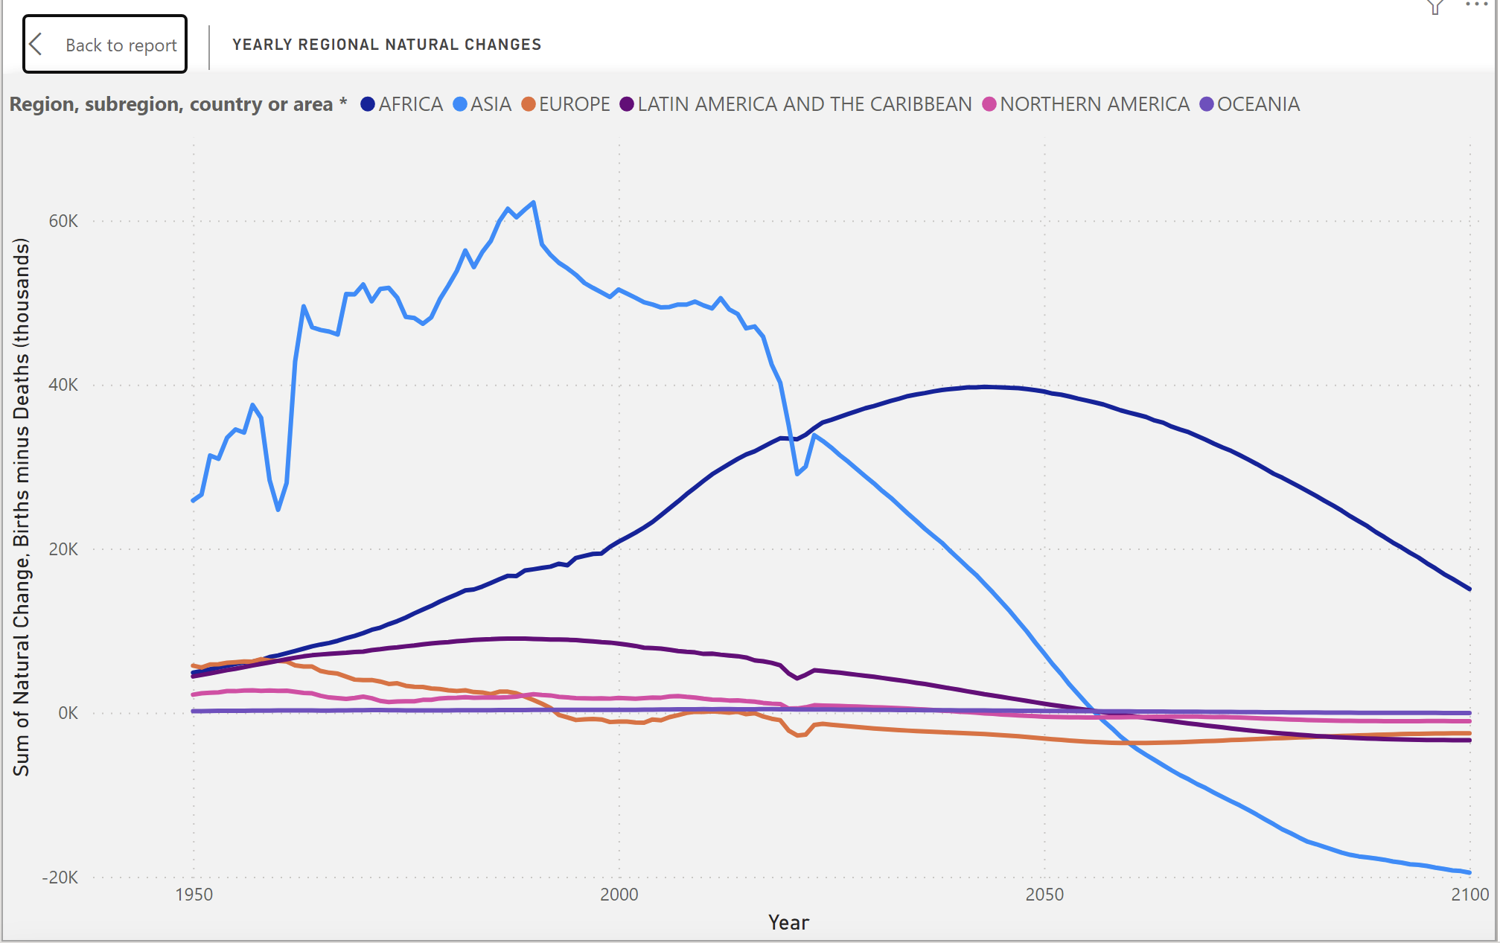
From the chat, Asian has the highest natural change rate next to Africa, Oceania has the list birth rate compared to the other regions, after 2020 Africa will have the highest natural change rate and will keep having the highest natural change and Asia will be having the lease natural change rate compared to other regions

Slide 17
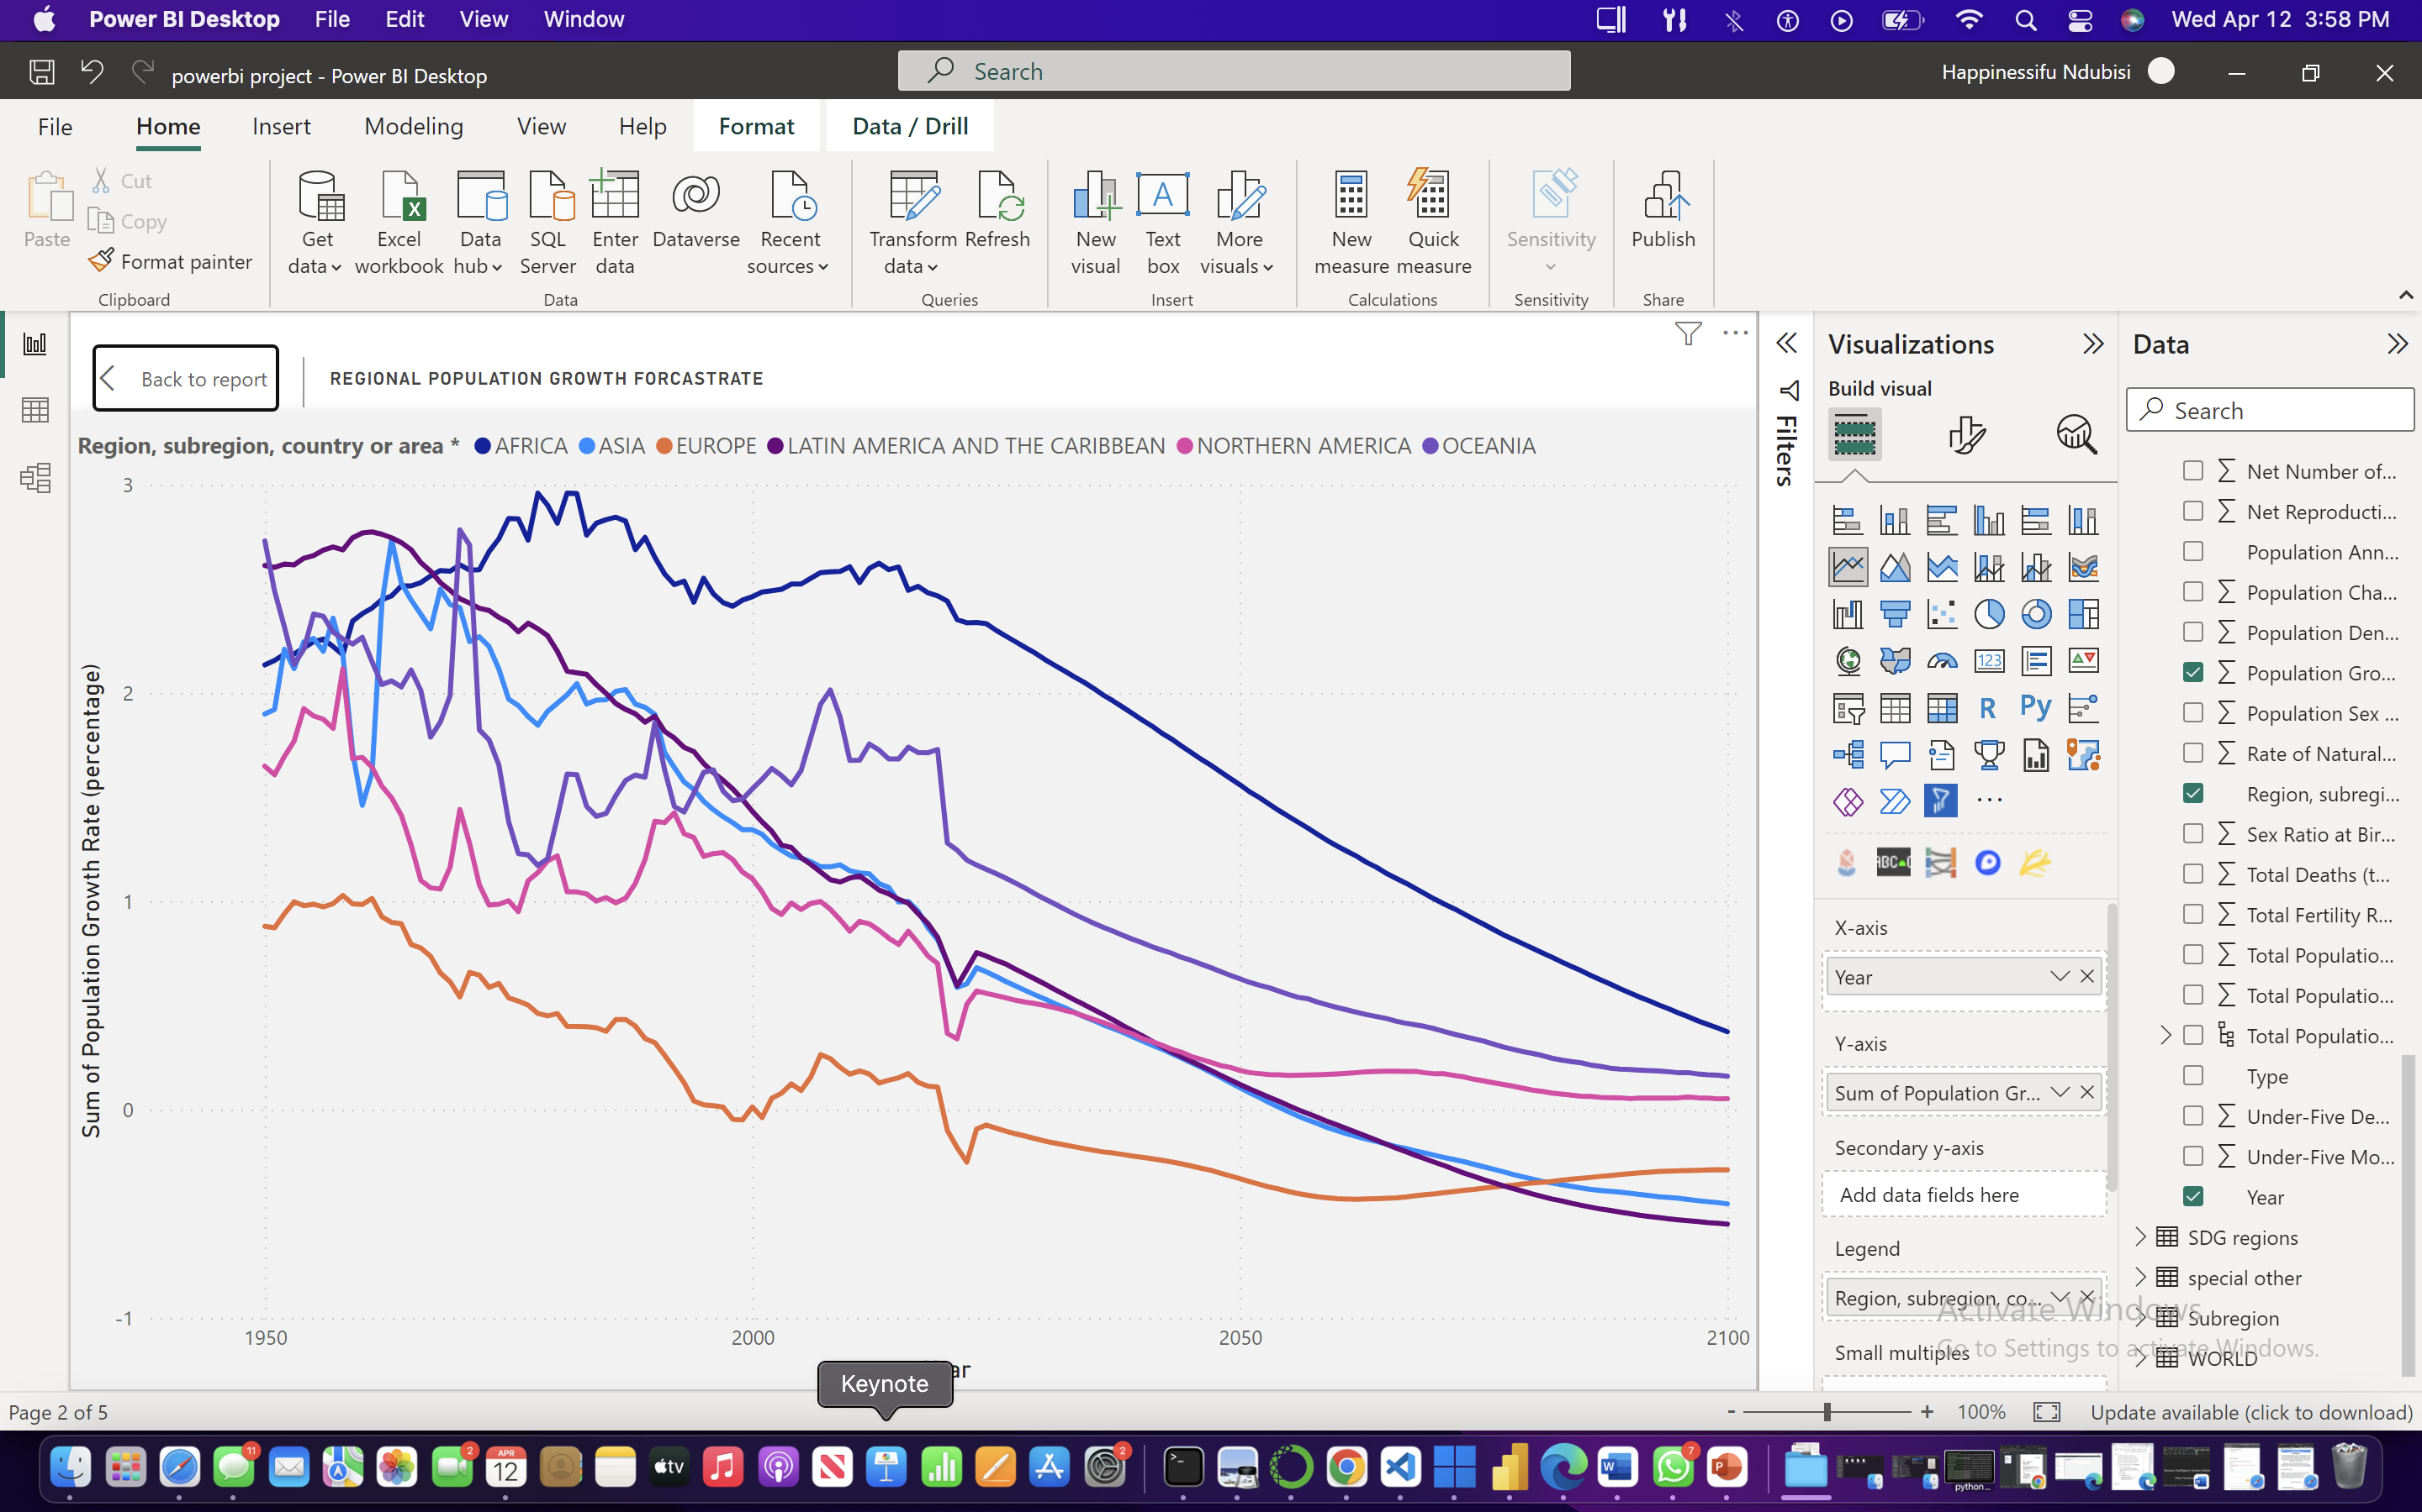
From the analysis, it is seen that population growth in each region is expected to continue increasing and eventual decline for all regions and as stated early Asian still have the highest population.

Slide 18
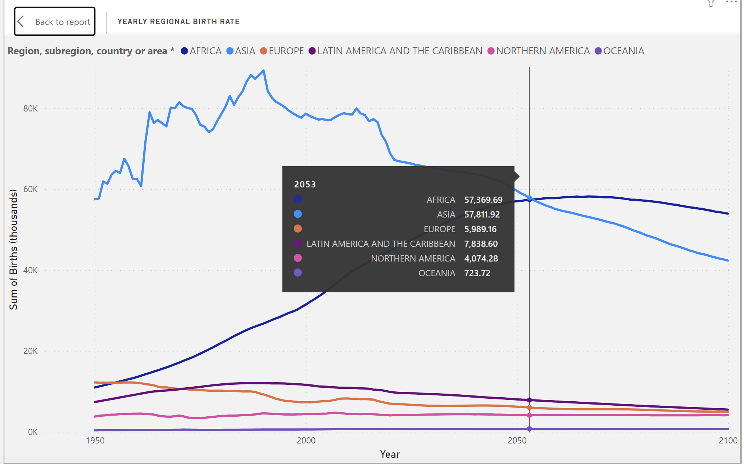
From the chat, Asia has the highest birth rate next to Africa, Oceania has the list birth rate compared to the other regions but from the future prediction, it is seen that in 2054 birth rate in Asia and Africa will be at same level and after which Africa will have the highest birth rate and ocean remains the least, from the chart Ocean is seen to have a constant birth rate.

Slide 19
Population analysis based on SDG regions and Development groups

Slide 20
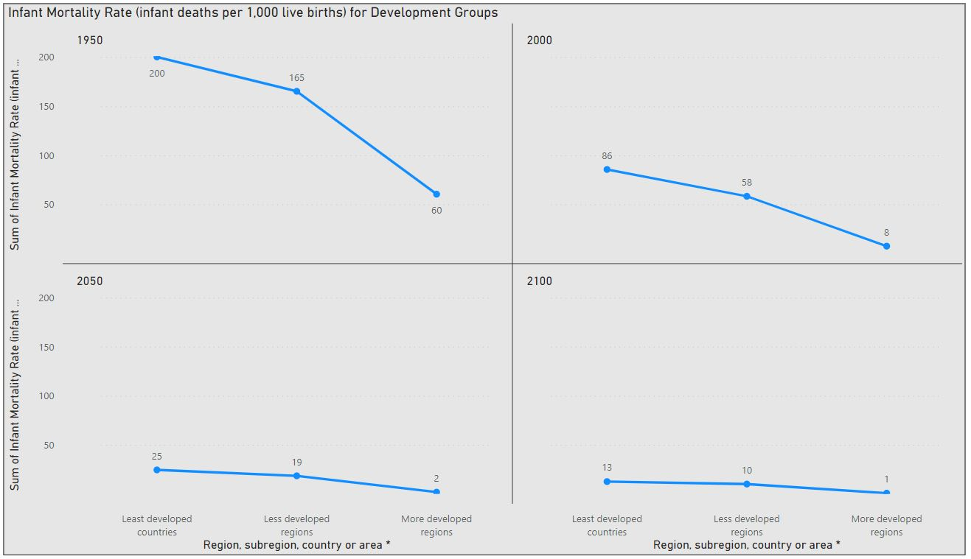
Infant Mortality Rate: For year 2100, Lowest is expected to be for the More Developed Groups with 0.84 as number and the highest would be for the ‘Least Developed Group’ with value of 12.62

Slide 21
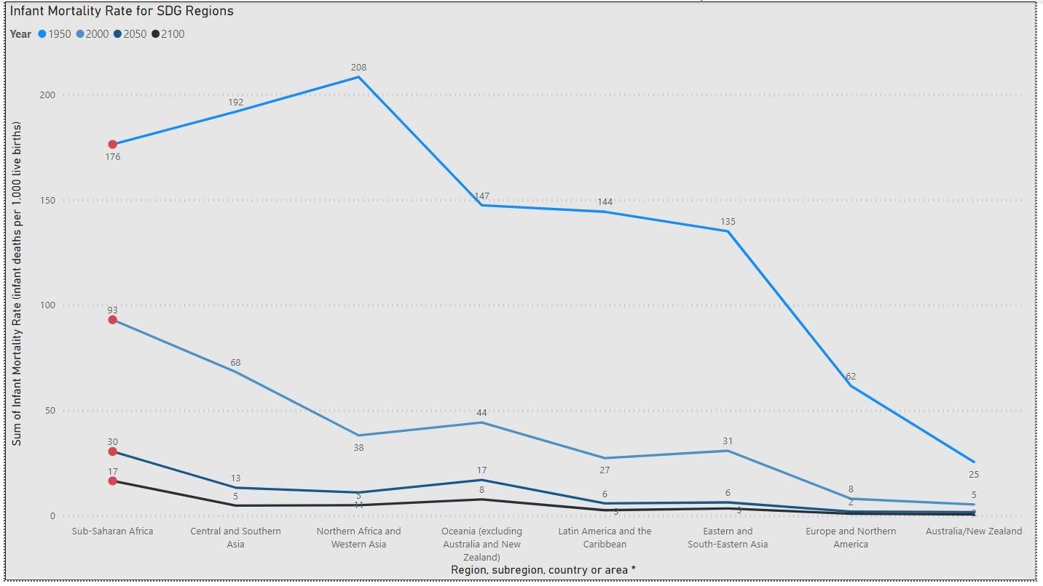
Infant Mortality Rate: In terms of Infant Mortality Rate, sub-Saharan Africa would be having the highest IMR of 16.51 followed by the people living in Oceania with 7.70 and least would be expected in Australia/New Zealand having value of 0.51.

Slide 22
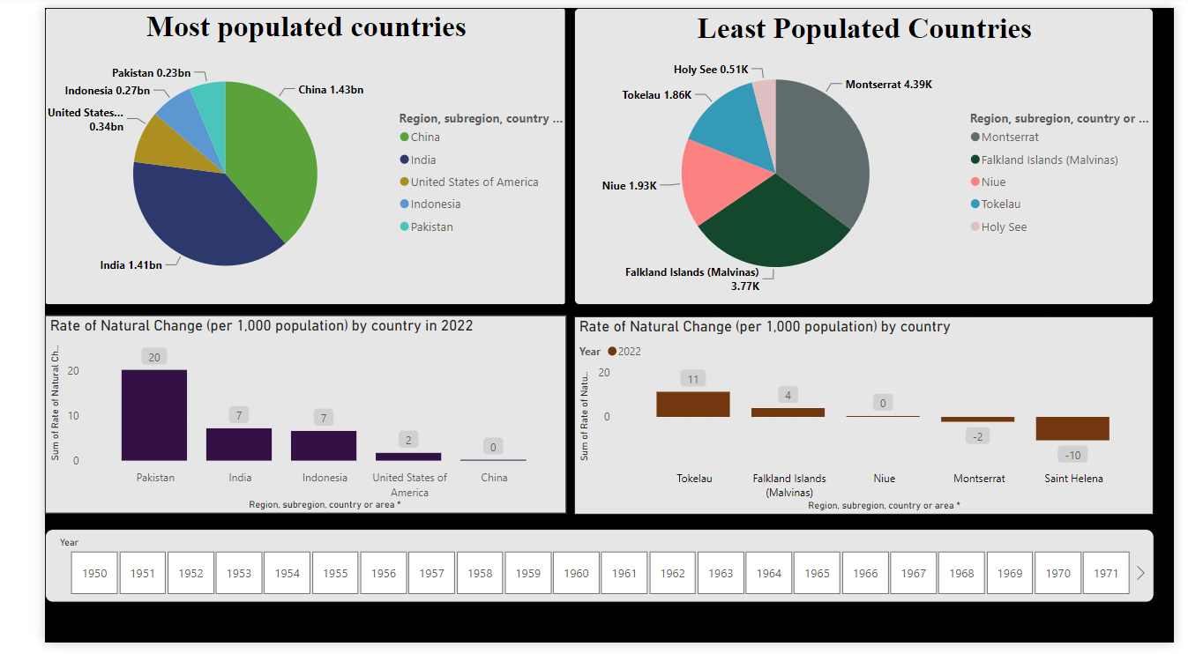

Slide 23
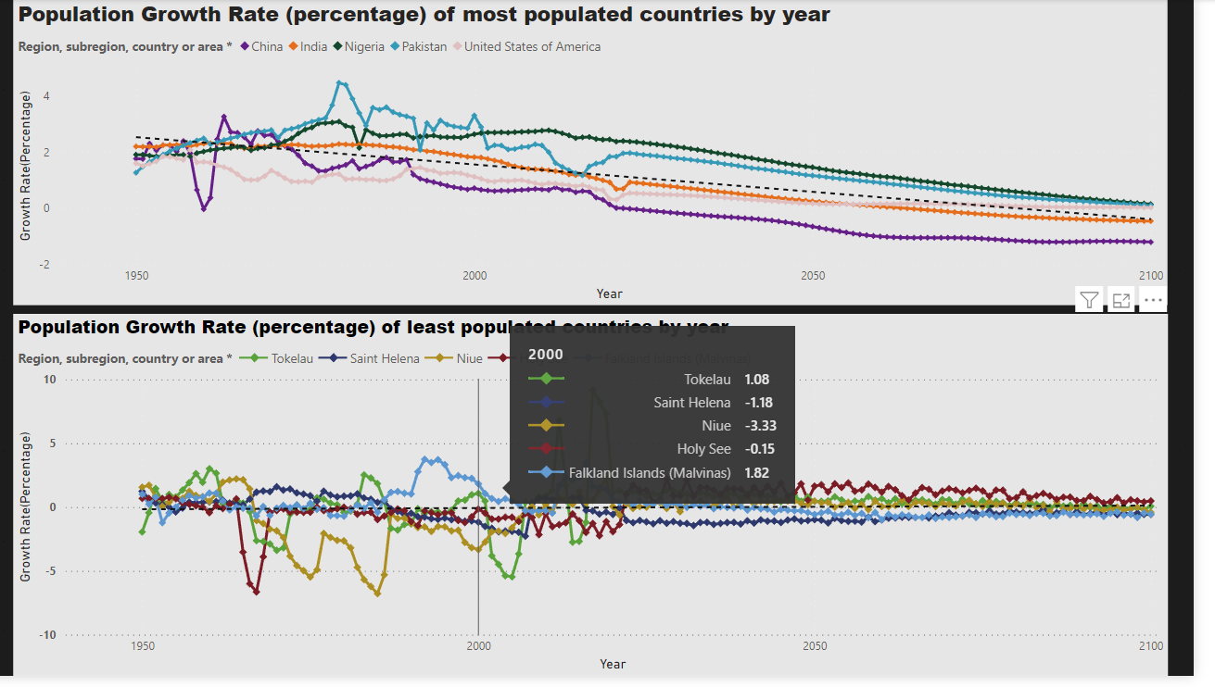

Slide 24
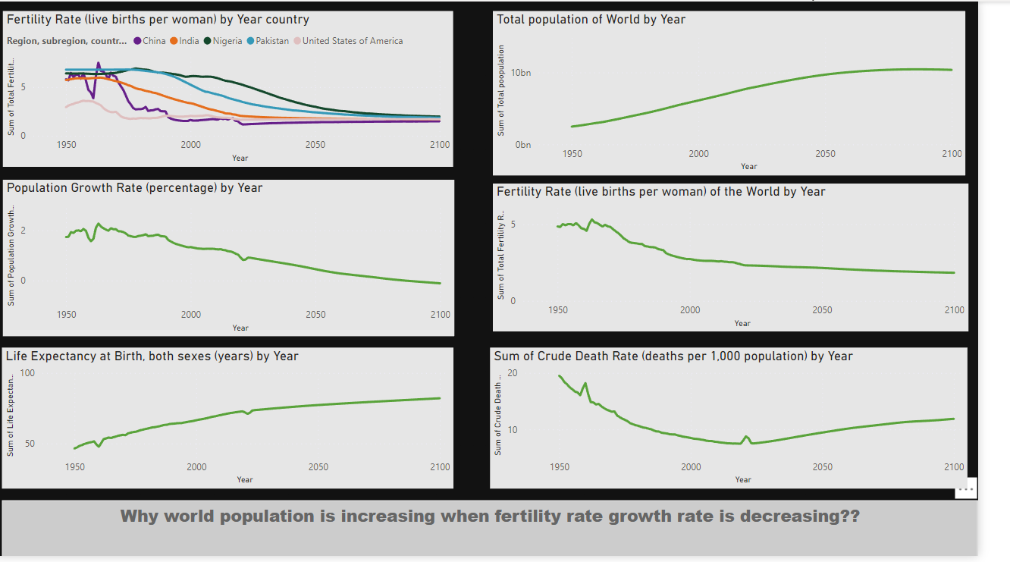

Slide 25
References
[1] Pew Research Center. (2020, July 7). Facts on U.S. immigrants, 2018. https://www.pewresearch.org/hispanic/2018/11/15/facts-on-u-s-immigrants/
[2] The above reference follows the basic IEEE citation format for online sources with an author:
[3]. J. Smith, ‘Why North America Attracts High Numbers of Immigrants’ The Huffington Post, Jun. 1, 2019.
[4] “Migration data in Northern America,” Migration data portal. https://www.migrationdataportal.org/regional-data-overview/migration-data-northern-america July 10, 2022
‌ [5] United Nations, “International Migrant Stock | Population Division,” www.un.org, 2020. https://www.un.org/development/desa/pd/content/international-migrant-stock

Slide 26
CONCLUSION
In 2011, the global population reached the 7billion mark, it stands at almost 7.9 billion in2021, and it's expected to grow to around 8.5billion in 2030, 9.7 billion in 2050, and 10.9billion in 2100. Jul 11,2022.
China is forecast to lose almost half of its people by 2100, plunging from more than 1.4billion to 771 million inhabitants. Russia, Germany, South Korea and Spain are all set tojoin this downward movement, with their populations beginning to decline by 2030
The findings and insights generated through this visualized analysis, can be used to inform planners, policymakers, and stakeholders in making evidence-based decisions on various issues related to population dynamics, including economic planning, social policies, healthcare provision, environmental sustainability, and more. This project contributes to the global understanding of population trends, it influencing factor and their implications for sustainable development and societal well-being.

Slide 27
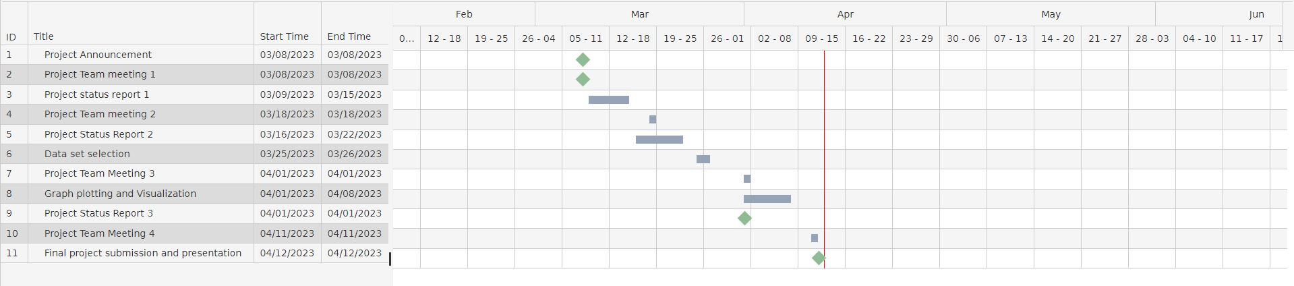
Gantt chart
Explanation of Project Workflow

Slide 28
WHO DID WHAT?
Karandeep Singh
Required dataset selection as per project sponsor requirements.
Data cleaning and joining
Prepared visualizations and Dashboards for the SDG(Sustainable Development Regions) and the Development Groups.
Gantt Chart
Final report
Final Presentation
Palak Rohela
Browsing through datasets and finalizing after the discussion with team members.
Data cleaning and joining
Prepared visualizations and Dashboards for the World Population Analysis and presentations for each week
Final report
Final Presentation

Slide 29
WHO DID WHAT?
Happiness Ndubisi
Discussion and finalization of Topic chosen and dataset selection as per project sponsor requirements.
Data cleaning and joining
Prepared visualizations and Dashboards for the Region Base Analysis and assigning work to team members
Final report
Final Presentation
Anurag Singh
Browsing through datasets and finalizing after the discussion with team members.
Data cleaning and joining
Prepared visualizations and Dashboards for the World Population Analysis and analysis based on Countries
Final report
Final Presentation

Slide 30
Thank You

